Slide 1
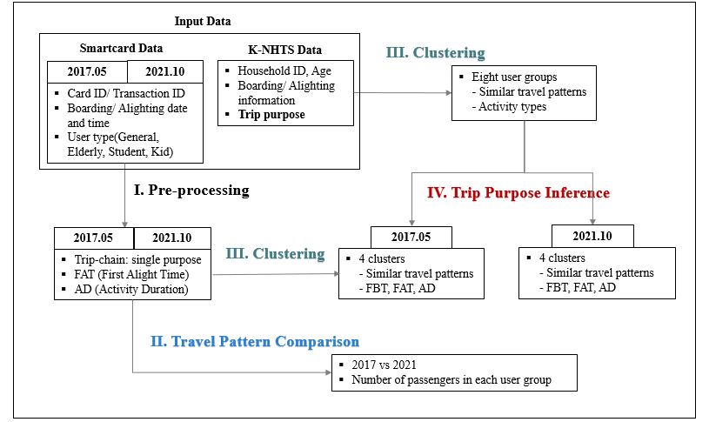
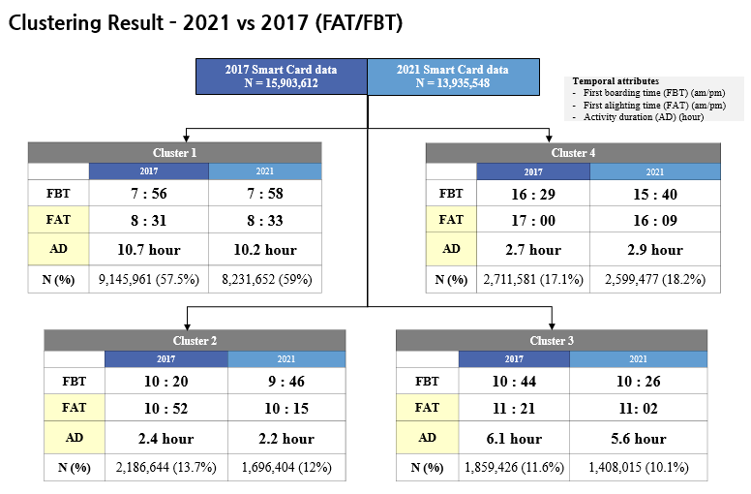
Analysis of changes in travel patterns and travel purpose of smart card users before and after COVID-19 Researcher: Eunjung Kim
What is the problem?
There have been dramatic changes in both travel pattern and travel purpose of public transportation users due to the effect of social issues such as COVID-19.
However, discovering the changes in travel pattern is one of the most important but also challenging issues in transportation field.
Why is this problem important?
Understanding the travel pattern and travel purpose is significant in terms of effective public transportation system management.
Travel patterns vary by the type of user group and the travel purpose.
Therefore, in order to effectively operate the traffic system, it is necessary to analyze the travel pattern with the consideration of user type and purpose.
However, smartcard data is not applicable to perform the qualitative analysis even though it contains numerous trip information generated by public transportation.
How can we solve this problem?
In this research, the clustering analysis is used to discover the set of various travel patterns generated in smartcard data.
To impute specific travel purpose to each cluster, this research combines two different type of dataset: smartcard data and NHTS data.
Moreover, the main factors of the changes in travel patterns will be discussed through various statistical approaches.
Results
Comparison of Travel Pattern by User Ratio
What is key contribution?
Compare the changes in public transportation travel pattern between pre- and post-COVID-19 pandemic.
Demonstrate the travel pattern and purpose can vary depending on user type.
Discovering the social factors that mostly affect the change in public transportation travel pattern.

